Slide 1

AUTUMN PRE-SEASON BRIEFING 2023
ZOOM 4 SEPTEMber 2023

Slide 2

COACHING PHILOSOPHY
Long Term Athlete Development
Multi Event – Multi Discipline
Age Appropriate Competition
Competition as Development Tool
Athletes must compete in Power of 10 eligible competitioms.
TO BE THE BEST

Slide 3

COMMUNICATION
WHATS APP
Community
will allow us to contain our many Groups for each specific days or events in one folder.
Mobile no: 07762252044

Slide 4
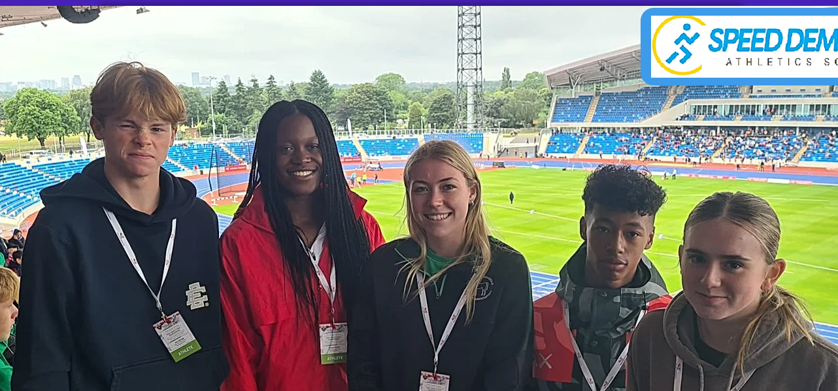
WEBSITE:
WEBSITE: www.bucks-speed-demons.info

Slide 5
COMMUNICATION GUIDELINES
WHATS APP
Usually send messages DIRECT (DM) to Ala / Speed Demons
–do not share on Community or specific group chats.
USE RELEVANT CHATS ONLY , & COMMUNITY ONLY WHEN IT IS NECESSARY TO GET MESSAGE TO EVERYONE!
WEBSITE
Increasingly we will open up the website for communication and Info sharing.
We will be deleting all existingMemberships on the website and encouraging everyone to sign up as members to the site.
This will mean we will not need to issue Group Passwords – each individual have their own.

Slide 6


FACEBOOK & INSTAGRAM
Occasional USE

Slide 7


DROPBOX & YOU TUBE
Storage Media in Use

Slide 8


MEDia NOW DELETED
No longer in use by squad

Slide 9
SESSION PLANNING
September 2023 to March 2024

Slide 10
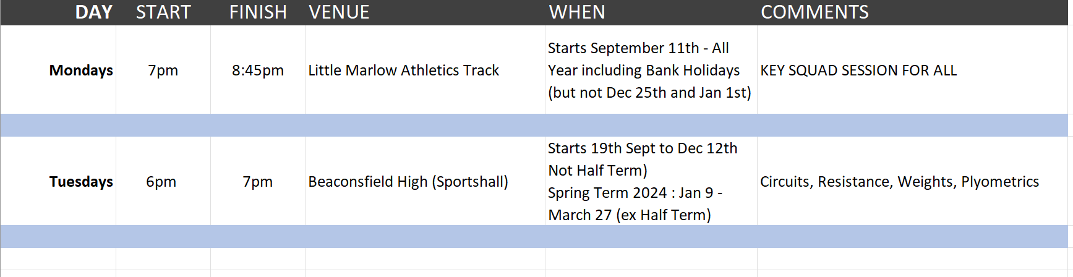
Mondays & Tuesdays

Slide 11
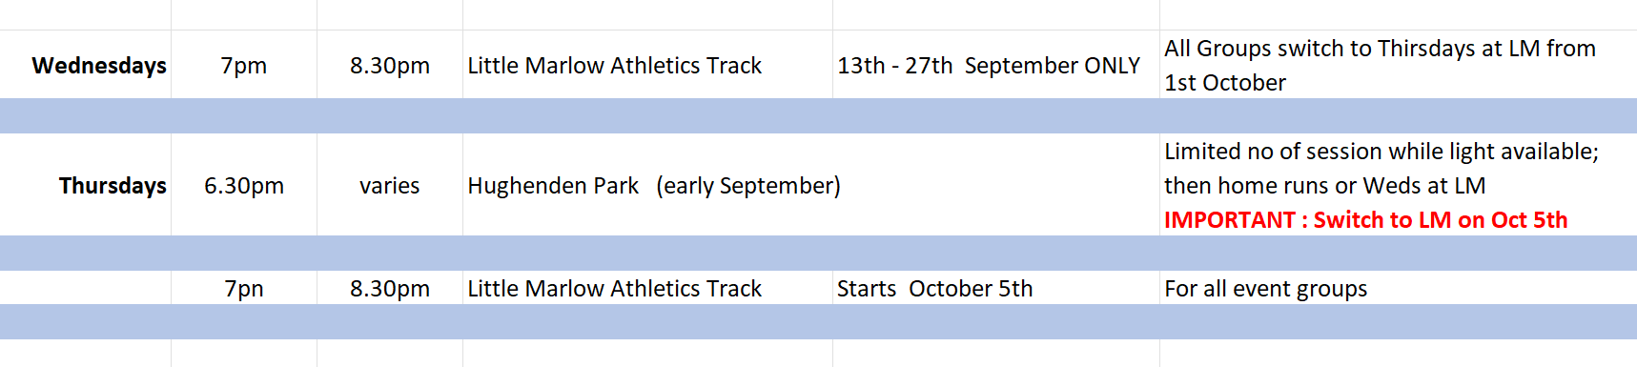
WEDNESDAYS & THURSDAYS

Slide 12
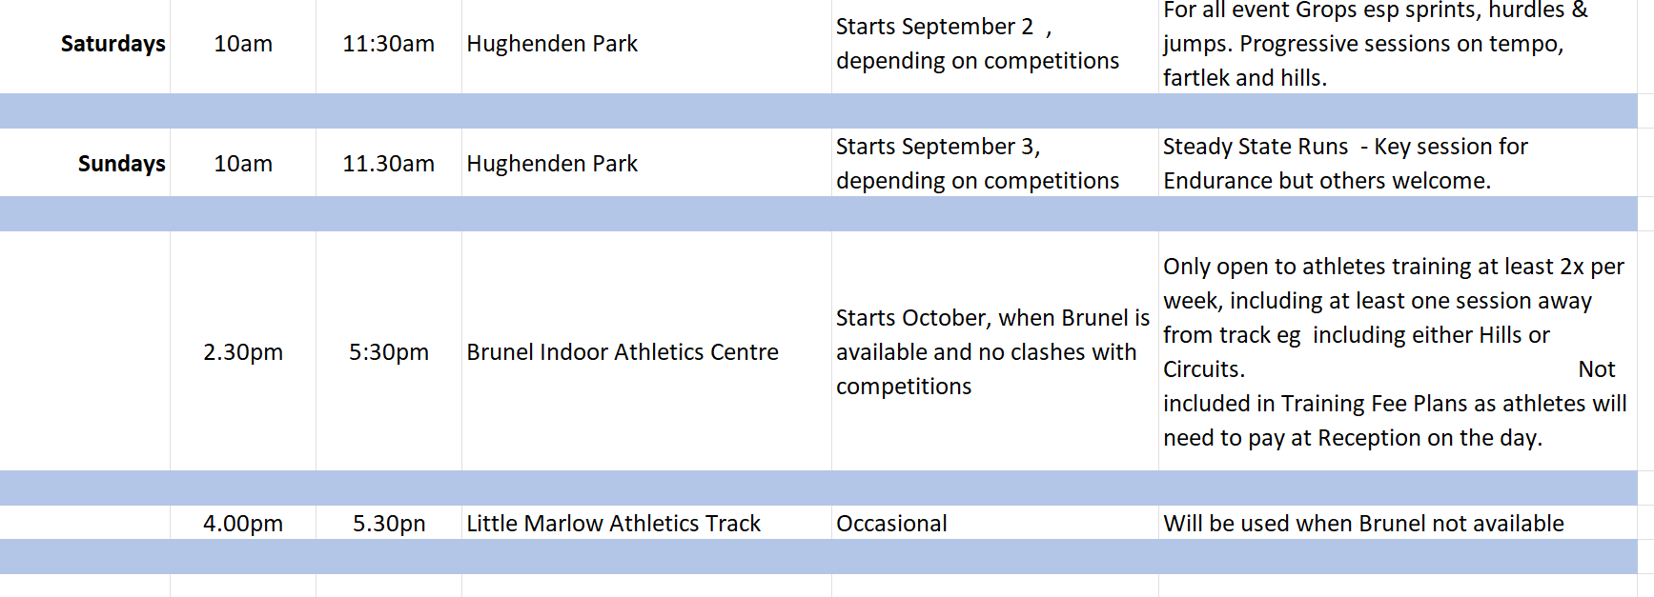
Saturdays & Sundays

Slide 13

IMPORTANT SESSION GUIDELINES
Parents must inform Coaches of any health problems, current injuries, and asthma diagnosis
Anyone with Asthma must bring up-to-date inhalers at all times
All athletes must turn up with full kit at all times over the Autumn and winter including covered legs/arms.
Athletes must turn up fueled for all sessions eg banana or flapjack. But NOT a full meal just before a session start.
Equally refuelling after and hydrating during and after the
session are critical

Slide 14
IMPORTANT SESSION GUIDELINES
Athletes must wear appropriate footwear for all sessions.
Beware of some items sold in stores - Maybe fashionale but impractical!
Spikes not required at track for next 2 months
Do not train if injured or sick. Do let us know you will not be turning up.
Advise the Coach at start of session if had a busy day of sport and exercise at school or elsewhere.
Consider the impact of your full weeks training on your welfare and health.
YOU WILL NOT PERFORM AT YOUR BEST IF YOU DO TOO MUCH!!!

Slide 15
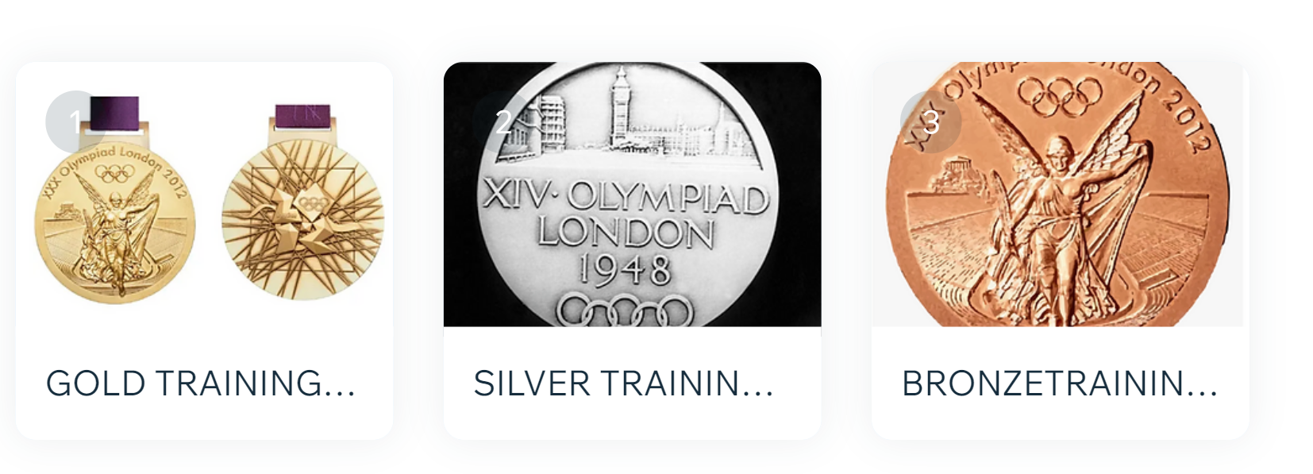
BOOKING FOR SESSIONS
First, you must complete an online Registration Form, giving full contact details, emergence, medical and welfare data and consents. This will also include the days which you plan to train on.
You will also agree to taking part in competitions.
Once completed , we will receive an email conformation. Later this week we will send you details of the link for paying your fees.

Slide 16

AND
COMPETITIONS?

Slide 17
AND
COMPETITIONS?
CROSS-COUNTRY
INDOOR MEETS
SPORTSHALL ATHLETICS

Slide 18
HELP !!

Slide 19
HELP !!
SESSION REGISTRATION
OFFICIALS - VERY IMPORTANT!!
COACHING TEAM
Must subscribe / commit to the
Squad Coaching Values & Philosophy

Slide 20
NEW RECRUITS VERY WELCOME!
Must be willing to compete
Must be willing to train all year round
We cannot accept people who just wish to get fit for other sports or purely for school exams
Simply pass on contact details:
Email: speed.demons@live.co.uk / mobile 07762252044

Slide 21
ANY QUESTIONS……??

